Slide 2
Partnerships to Drive Success and Savings
PRESENTED BY
Tammy Biery, Executive Director – Career Solutions
tammy.biery@CSJobs.org
Della Ludwig, Workforce Strategy Consultant – Central MN, DEED della.ludwig@state.mn.us

Slide 3
Helps individuals train for and gain meaningful employment.
Career Solutions
Through:
Career counseling
Job training
Business relationships
This includes:
Entry-level to experienced workers
Youth to older adults
We help businesses:
Recruit
Train AND
Retain workers
We focus on providing a pool of qualified workers who will help businesses grow.

Slide 4
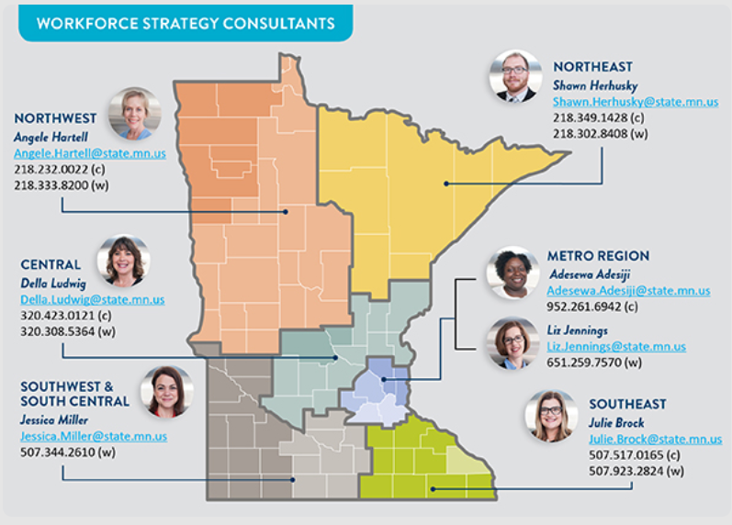
Workforce Strategy Consultant
Assist key stakeholders in the successful implementation of regional plan
Leverage expertise in sector workforce development strategies
Connect key stakeholders to workforce development resources
Design tools and resources to support businesses in developing strategic workforce solutions
For more information: mn.gov/deed/wsc

Slide 5
Partnerships to Drive Success and Savings
Today’s Agenda
Look at Hidden Talent Pools/Untapped Population Segments to Target
Discuss Programs and Grants Available
Offer Success Stories of Local Businesses
Give You Contacts and Information
Notes:
Tammy – discuss how this presentation will drive success and assist in savings.

Slide 6
Common Barriers to Employment
Mental Health
Addiction
Criminal history
Housing availability and prices
Employment for spouse / dependents
Transportation/Lack of Driver’s License
Daycare
Welfare "Cliff"
High School Diploma/GED
English as Second Language
Domestic Violence
No experience and/or underemployed
Cost of Living is $14.48/hour
Notes:
Della – Understanding the barriers to employments and what is your company’s culture to engage these barriers?

Slide 7
Hidden Talent Pools/Untapped Population Segments to Target
Immigrants
Dislocated Workers
Unemployed
Underemployed
Youth
Offenders
Veterans
Notes:
Tammy

Slide 8
Immigrants
Immigrant Employment Connection Group (IECG)
New American Job Fair – November 13, 2018
English as a Second Language (ESL)
Adult Basic Education (ABE)
Notes:
Tammy

Slide 9
Dislocated Workers
Eligibility:
18 and older AND
Permanently separated from employment due to no fault of their own
Services:
Career Assessment
Career counseling
Job seeking and resume assistance
Training / on-the-job training
Support Services
Goal: To ensure job seekers are able to secure permanent jobs in high-demand occupations as soon as possible
Notes:
Tammy – discuss services are available for all positions at an level (OJT)

Slide 10
On the Job Training (OJT)
Incentive for hiring - minimize new hire risk
Business trains new employees to their specific skill requirements
Business is reimbursed for the cost of training new employees
Reimbursement is 50% of the new employee’s hourly wage for the length of the contract
Notes:
Tammy

Slide 11
Resources for the Unemployed
St Cloud Workforce Center
Job Services
Vocational Rehab Services
State Services for the Blind
Veterans
Partners of the Workforce Center
Career Solutions
Avivo
Notes:
Della

Slide 12
Workforce Centers
https://mn.gov/deed/job-seekers/workforce-centers/workforce-center-locations
Notes:
Della

Slide 13
Career Fairs
https://mn.gov/deed/job-seekers/find-a-job/job-career-fair
Notes:
Della

Slide 14
MinnesotaWorks.net
Notes:
Della

Slide 15
Underemployed
Programs/Grants Available:
MN Job Skills Partnership (MJSP)
http://mn.gov/deed/mjsp/
Job Training Incentive Program (JTIP)
https://mn.gov/deed/business/financing-business/training-grant/jtip/
Dual Training/PIPELINE
www.doli.state.mn.us/Pipeline
Minnesota Apprenticeship Initiative (MAI)
https://mn.gov/deed/business/finding-workers/incentives/mai.jsp
Notes:
Della – discuss the programs and $ available in the grants (5-10 min)

Slide 16
Companies Who Have Received Grants
AAM/Grede – MN Job Skills Partnership (MJSP)
CentraCare – MN Apprenticeship Initiative (MAI)
DeZURIK – PIPELINE
New Flyer of America – MN Job Skills Partnership (MJSP)
Miller Marine – MN Apprenticeship Initiative (MAI)
Park Industries – MN Job Skills Partnership (MJSP)
Rock On Trucking – MN Apprenticeship Initiative (MAI)
Talon – MN Job Skills Partnership (MJSP)
Notes:
Della – discuss the programs the companies are running (5-10 min)

Slide 17
Outside the Box Hiring
Horizon Roofing in Waite Park, MN
1 week free training in roofing, sheet metal and service positions
Enter the workforce earning up to $18/hour
Midwest Industrial Tool Grinding, Inc. (MITGI) in Hutchinson, MN
Paid, day-long interview so job seekers can see the culture and understand the job they will be doing
Coldspring in Cold Spring, MN
Work closely with the ROCORI school district and sponsors the school’s Robotic’s team
Mille Lacs Health System in Onamia, MN
Works closely with Onamia and surrounding school districts to get students CNA Certified
Notes:
Della (2-5 min)

Slide 18
Outsourcing Opportunity
WACOSA
Machine aided assembly - Collating/Envelope stuffing
Hand assembly - Labeling
- Packaging/Kitting - Bulk mail/mail services
Re-Work - Fulfillment/Shipping services
Quality checking
Notes:
Tammy

Slide 19
Youth
CareerONE
St Cloud, Sauk Centre and Paynesville
Coleman Project: https://vimeo.com/268631068
Apprenticeships
Certified Youth Apprenticeships (MN Department of Education)
https://education.mn.gov/MDE/dse/cte/exp/youth/index.htm
Youth Skills Training Program (Department of Labor and Industry)
http://www.dli.mn.gov/yst
Notes:
Tammy

Slide 20
Companies Who Have Received Youth Grants
Youth Skills Training
Hutchinson High School
Certified Youth Apprenticeship
Engel Metallurgical
Louis Industries
Maus Motors
Park Industries
Rotochopper
Silt Sock
Woodcraft Industries
Notes:
Della – discuss their programs (5-7 min)

Slide 21
Offenders
New Leaf Employment
Connecting ex-offenders with gainful employment
Assist offenders by
Teaching life skills
Providing clothing and support
Providing transportation
http://newleafemployment.com/
Notes:
Della

Slide 22
Twin Cities R!SE
MN Employer’s Fair Chance Hiring Guide
Legal Compliance and Minimizing Risk
Checklist of Action Steps to Improve “Fair Chance Hiring” policies and practices
Nature-Time-Nurture Test
How to Comply with Background Check and “Ban the Box” Laws
Rewards of Hiring Fair Chance Workers
Common Questions about Business Insurance
Best Practices for Onboarding and Training
http://www.twincitiesrise.org
Notes:
Della

Slide 23
Veterans
Workforce Center
Veterans Employment Representative
Mike Eisenstadt: michael.eisenstadt@state.mn.us
Veterans Employment Connection Group
St Cloud VA
Community Employment Coordinator
Brad Steele: bradley.steele@va.gov
Notes:
Tammy

Slide 24
Population Segments to Target
Immigrants
Dislocated Workers
Unemployed
Underemployed
Youth
Offenders
Veterans
Notes:
Tammy

