Slide 2
Talent Shortage? Develop From Within!
PRESENTED BY
Eric Gibson, President
Jaci Dukowitz, Director

Slide 3
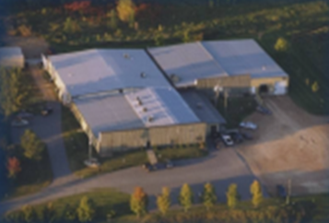
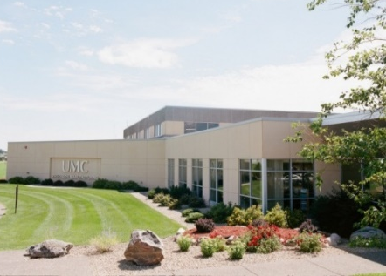
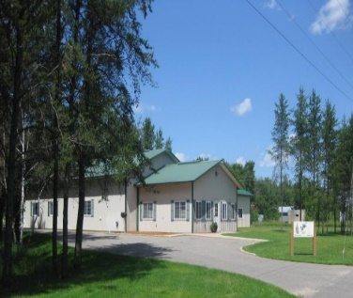
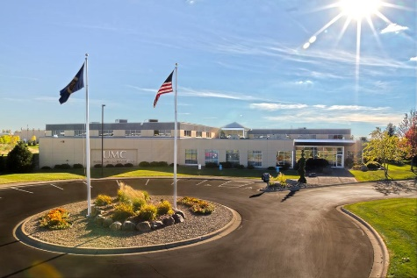
History
1968
1972
2003
2010
2018
Medina, MN
Company founded
in Tomann family
garage
Hamel, MN
Orig. Size: 5,000 sq. ft.
Exp. Size: 33,000 sq. ft.
Monticello, MN
Size: 72,000 sq. ft.
Employees: 166
Pine River, MN
Size: 6,500 sq. ft.
Employees: 5
Monticello, MN
Size: 72,000 sq. ft.
Employees: 210
2007
2015
Closed Pine River
2nd Generation Ownership
Don and Jenny Tomann along with 5 minority owners

Slide 4
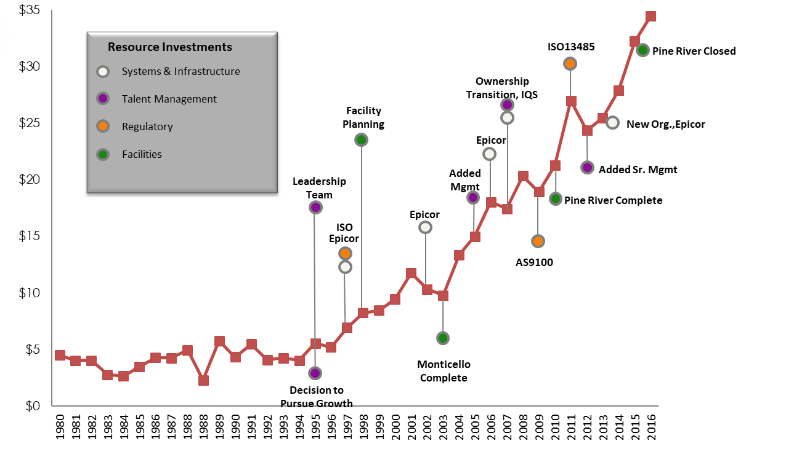
Revenue History

Slide 5
SWOT Analysis 2013
Technical
Established
Reputation
Aging workforce
Machinist reliant
Little to no management bench
STRENGTH
WEAKNESS
OPPORTUNTIES
THREATS
Re-brand the business
Bring in new talent
Automate
Lack of talent/workforce
Customer concentration
Retention and attraction

Slide 6
The Timeline
2013
2014
2015
President
New Organization Structure
Compen-sation Grades & Banding
PTO and Holidays
Front Office Remodel
TRACTION
Summer Interns
STEM Summer Program
Machinist leveling
Created Project Management
Added training headcount
Added recruiting headcount
Created event committee
2016
Consolidate ERP
Created the SPIRIT Award
2017
2018
Performance review upgrade
Corporate Psychologist for Leadership Assessment
Idea Exchange Teams
Added patio
Created supervisor role
Began development plans
Core Values
Engineering Interns
Job Descriptions Formalized

Slide 7
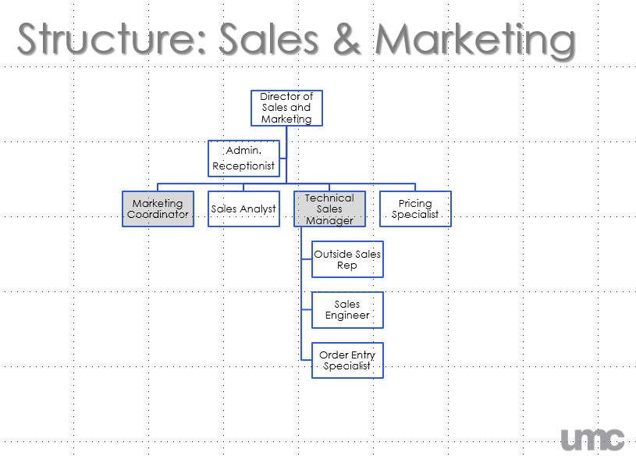
2013 The Organizational Structure
Created the functional areas
Filled in roles needed to meet customer expectations
Brief responsibility bullets on each role
NO NAMES and rules for draft
4 rounds of UMC Draft with Post-it Notes
8 employees didn’t fit
Friday notification and 40% of workforce had new role, were sitting or working somewhere different and had new direct supervisor

Slide 8
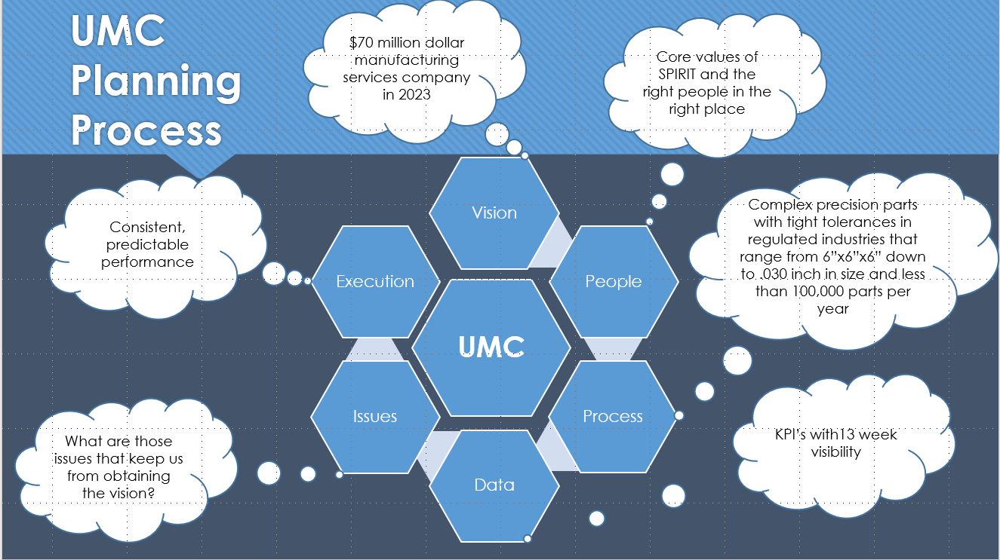
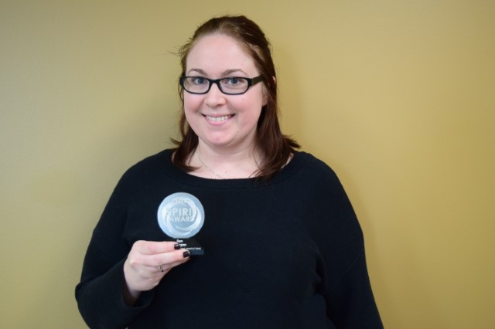
2014 EOS/TRACTION and Core Values
Self-implemented the TRACTION planning process
Created future vision
Developed meeting cadence
Established core values (SPIRIT) of:
Service
Passion
Integrity
Remarkable
Ingenuity
Team

Slide 9
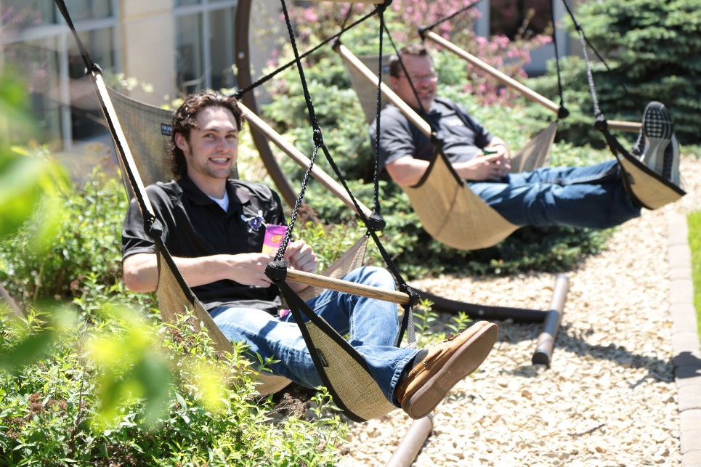
2015 PTO & Holidays
Employees had to wait 10 years to get to 15 days of PTO
2 holidays converted into PTO
Moved 15 days up to accrue from day one
Designed to attract younger workers to the business

Slide 10
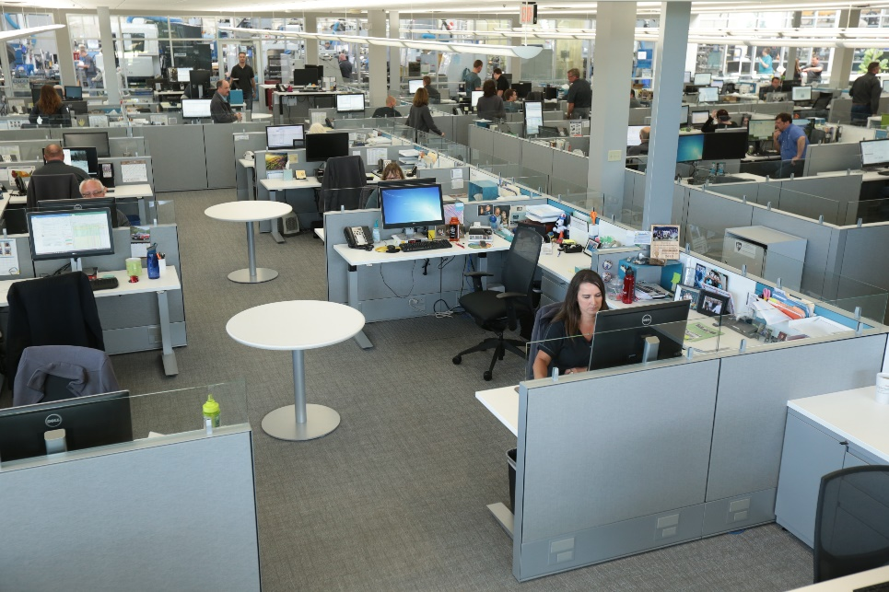
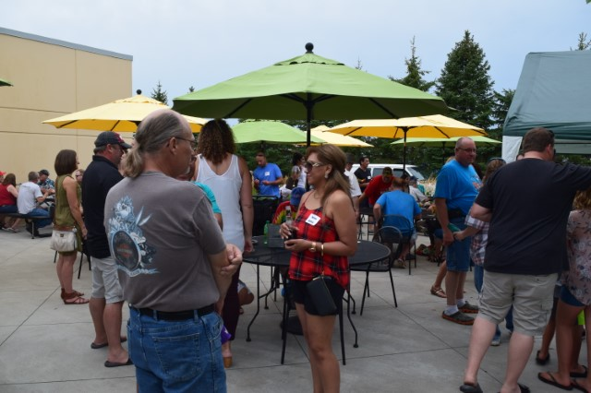
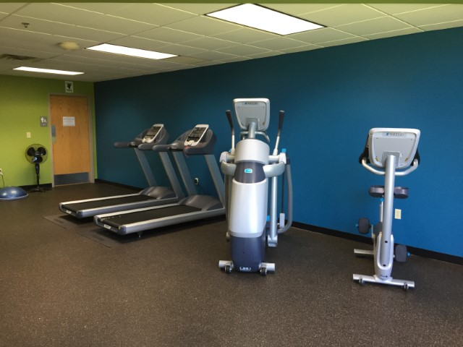
Office Remodel, Fitness Room & Patio Addition
Notes:
Eliminated beige 5’ cubes
Created collaborative work areas
Sit-to-stand desk for all office personnel
White noise to limit disruptions
Consolidated reception desk
Tables and patio furniture
Added state of the art fitness equipment

Slide 11
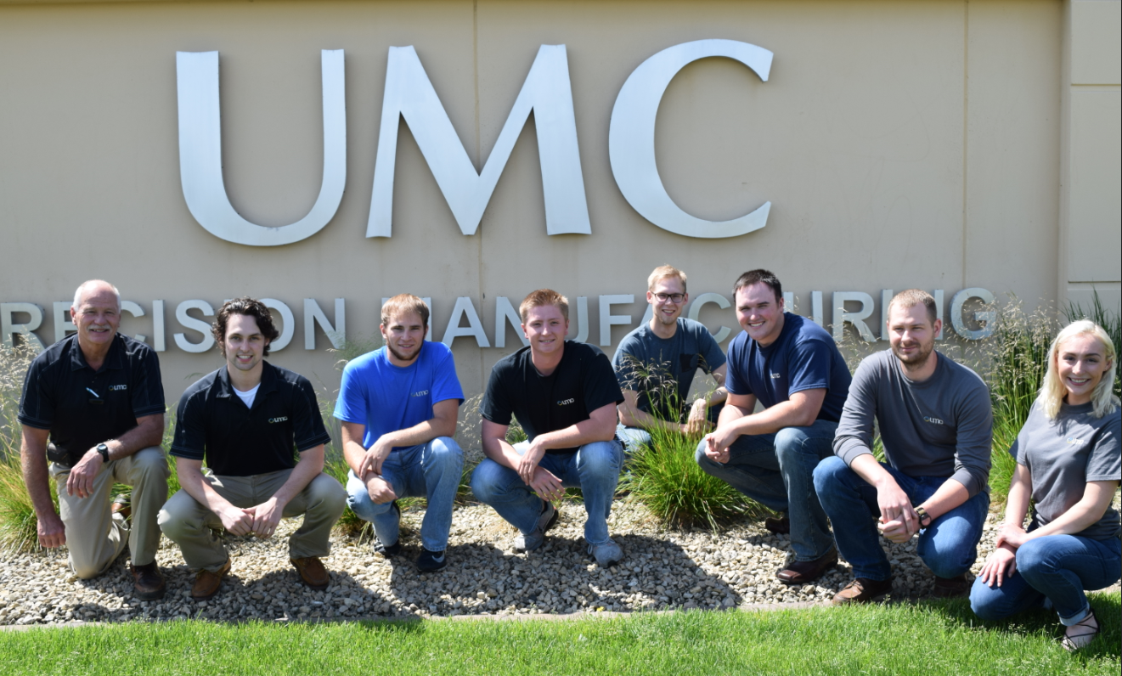
2015 Engineering Internship Program
Started recruiting on college campuses
Began with 6 engineering interns
Created an experience program
Rotation and site visits/tours
Final project
Sci-Tech Sperience Funding

Slide 12
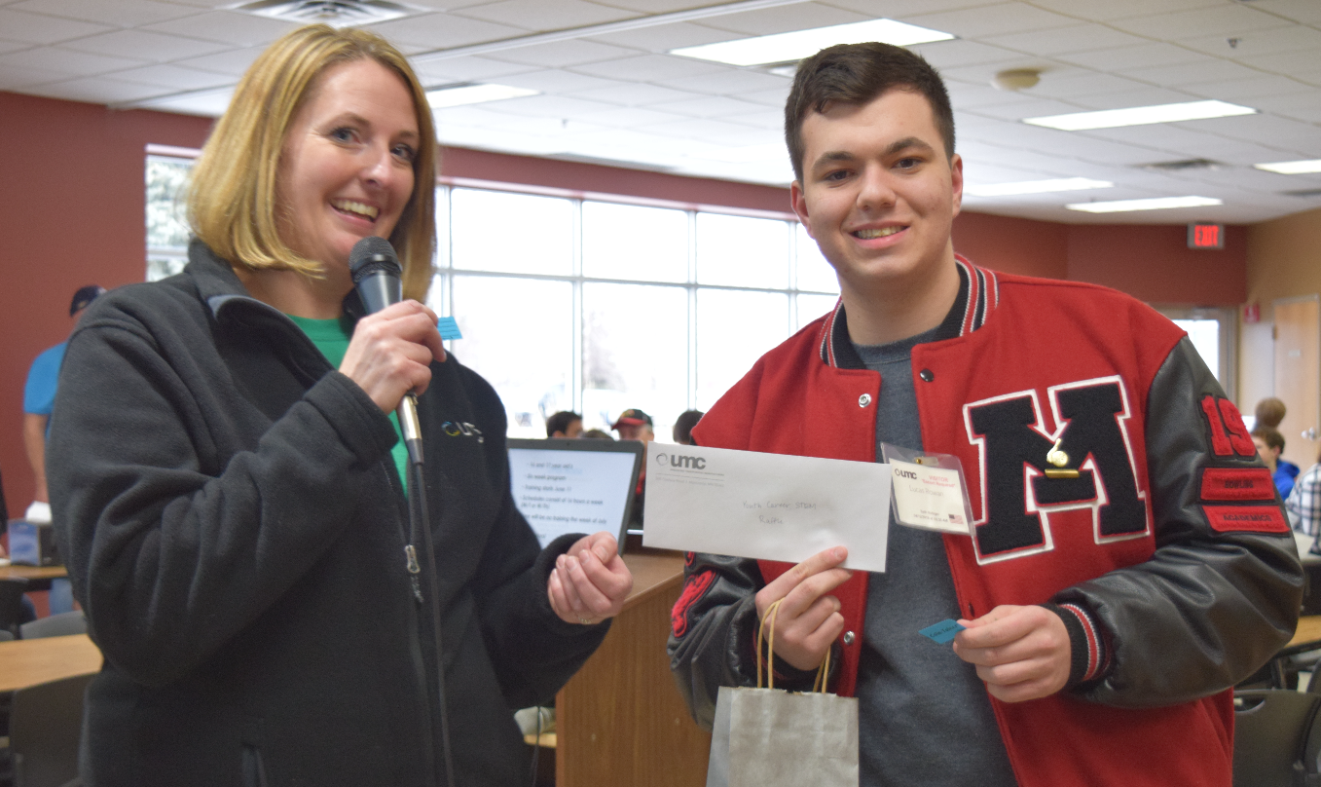
2016 Training & Recruiting Headcount Added
Headcount for both disciplines
Led to standardizing on-boarding process
Business to college programs
Funding for on-site and campus
Pipeline Grant Funding
MN State University Mankato Grant for Compliance OJT

Slide 13
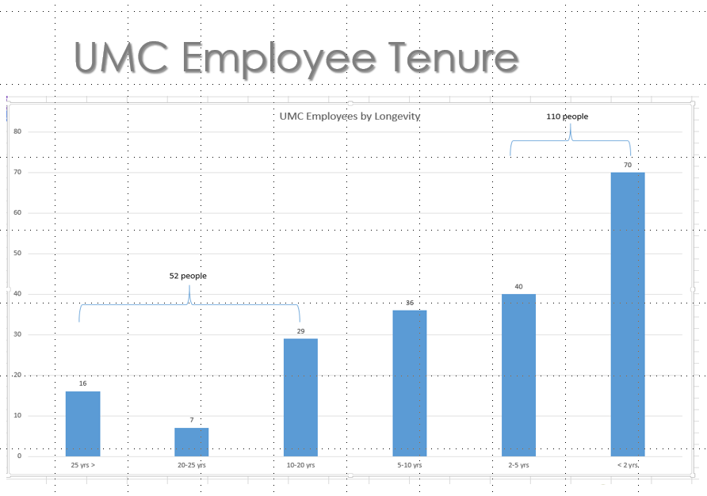
2016 Idea Exchange Meetings
Objective to engage long term employees while recruiting the next generation
Three teams organized by ten-year
Presented three (3) business challenges for input
Shared in the success

Slide 14
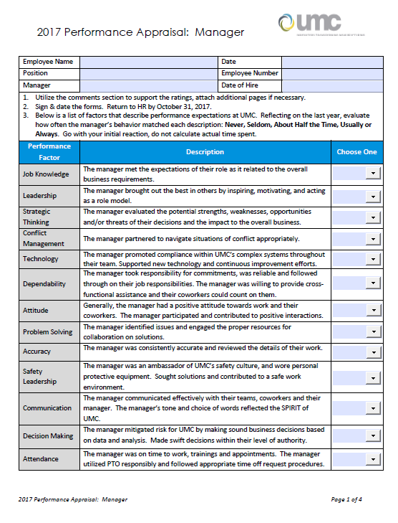
2017 Performance Appraisal Upgrades
Standardized to three forms
Updated evaluation criteria
Included the SPIRIT
Added frequency
Included development discussion

Slide 15
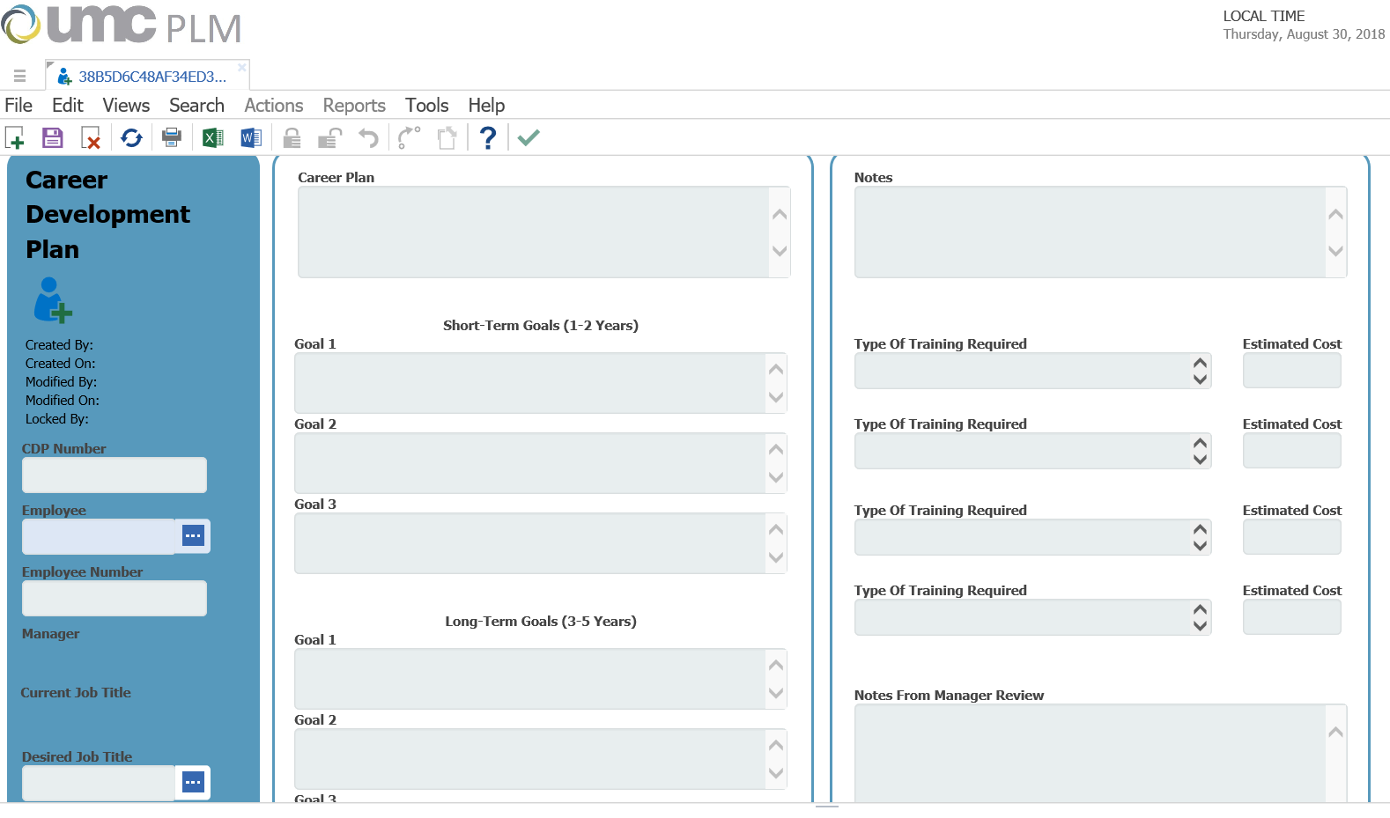
2017 Career Development Plans
Led by training specialist
Driven by managers
Simple forms
Employee’s responsibility

Slide 16
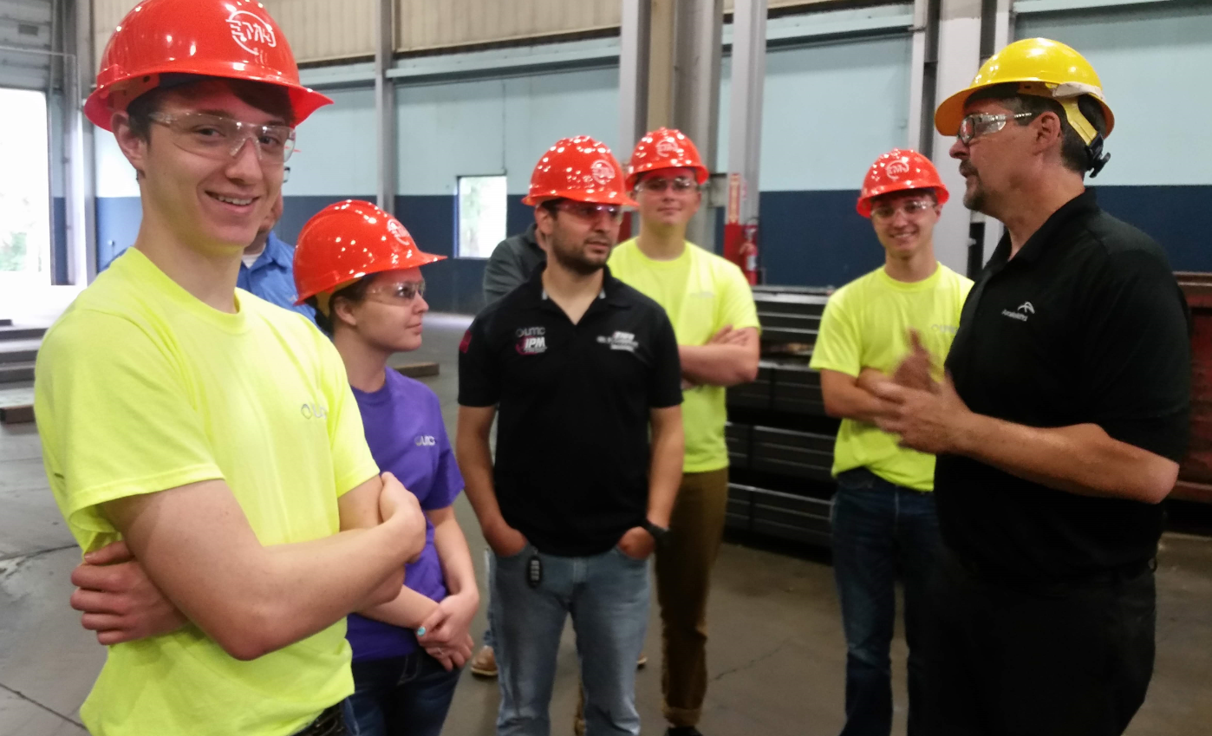
2018 Youth Skills Program (STEM)
Broad Partnership/Recruitment efforts
“Exposure Focused”
Led by training specialist
Two groups of sophomores and juniors
One group Tues and Wed and the second group Thursday and Friday
Submitted for grant funding, but did not receive
Internally funded

Slide 17
Careers, not Jobs
STEM Student Year One
STEM Student Year Two
Youth Apprentice
Machine Apprentice
Machinist I
Machinist 2
Machinist 3
Machinist 4
Engineering Intern
Manufacturing Engineer
Applications Engineer
Quality Engineer

Slide 18
Conclusions
Identify weakness and threats
Develop strategy
Communicate vision
Adjust and adapt
Track success and share wins

