Slide 1


Slide 2

Organizational Change
Position Your Business for Growth
PRESENTED BY
Joseph Hellie,CentraCare Health, VP Strategy & Dev.
JR Burgess, Rejuv Medical, CEO

Slide 3
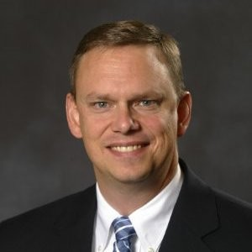
Joseph Hellie, CentraCare Health
VP Strategy & Network Development
Joe began his career as a nursing assistant and EMT in rural Iowa.
Joined St. Cloud Hospital in 1992. He has worked in clinic management, hospital operations, graduate medical education and regional disaster preparedness.
Joe is responsible for strategic planning, business development and mergers/acquisitions for CentraCare Health.

Slide 4
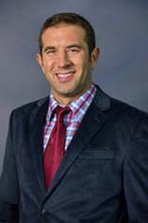
JR Burgess, Rejuv Medical, Chief Executive Officer
JR Burgess, MS, is the CEO of Rejuv Medical, Co-Founder of MedFit and HealthOvators, international speaker and two-time #1 bestselling author. With his business partners, Dr. Joel Baumgartner and Dr. Janna Vilen, JR is innovating healthcare with a model that prevents, reverses or better manages chronic pain and disease while supporting physicians to achieve these transformations profitably through business. Their revolutionary regenerative healthcare model includes non-surgical orthopedics, functional primary care and medical fitness.
Medical Fitness has proven to be the difference in their healthcare model and the main driver of successful clinical outcomes. Now replicated in clinics and wellness centers around the world, JR is coaching and empowering medical leaders and patients to co-create regenerative health together and positively impact the world.
JR is a husband and father; his faith is a priority for him.

Slide 5
ABOUT THEIR ORGANIZATIONS
CentraCare Health is a not-for-profit health care system.
CentraCare serves all who seek care with compassion, dignity and respect, while seeking to enhance individual and community health.
Provides comprehensive, high-quality care to people throughout Central Minnesota. Our collaborative network includes multiple hospitals, more than 25 clinics, along with nursing homes and senior housing in several communities.
Numerous specialty services, including the CentraCare Heart & Vascular Center, Coborn Cancer Center and the CentraCare Kidney Program.
Rejuv Medical specializes in:
Non-Surgical Orthopedics, Certified Personal Training, Physical Therapy, Functional Medicine, Corporate Wellness, HARDcore-Child/Adolescent Sports Training
Rejuv Medical offers careers in
Clinical Physician, NP, RN, LPN, CMA, MA
Fitness, CPT
Physical Therapy, DPT
Billing, RHIT & Accounting
Marketing
Administrative
HIT Professionals

Slide 6


